Slide 1
TEST TIME OPTIMIZATION
In Scan Circuits
Master’s Thesis Defense
Thesis Advisor: Dr. Vishwani D. Agrawal
Committee Members: Dr. Adit D. Singh, Dr. Charles E. Stroud
Priyadharshini S.

Slide 2
Problem Statement
Reduce test time without exceeding power budget
  Test power and test time are known problems
    Increasing test frequency increases test power - undesirable

Slide 3
Background
Scan design
  Chain flip-flops to form shift register during test
  Test vectors scanned in and responses scanned out through mentioned shift register
  Flip-flops function as points of observability and controllability
Scan-out
Scan-in
Scan design

Slide 4
Background
External Test
  Also known as stored pattern testing
    Automatic Test Equipment (ATE) used for testing
    Test patterns and good circuit responses generated by ATPG stored on ATE
  Patterns applied to Device Under Test (DUT)
  Responses from DUT compared with good circuit result
Built-in Self Test (BIST)
  Circuit tests itself
  Test per scan BIST
    BIST circuit applies one test per scan vector
    Scan-in of test vector, one test clock, scan-out of captured response
BIST implementation

Slide 5
Test Power Considerations
Circuit activity increases during testing and leads to high test power dissipation
  Drop in power supply voltage due to IR drop
    Drop in voltage lowers current flowing through transistor
    Time taken to charge load capacitor increases
      Causes stuck and delay faults
  Ground bounce
    Increase in ground voltage
    Incorrect operation of transistors
      Causes stuck and delay faults
  Excessive heating
    Permanent damage in circuit
  Good chip labeled bad => unnecessary yield loss
Test clock frequency lowered to reduce power dissipation

Slide 6
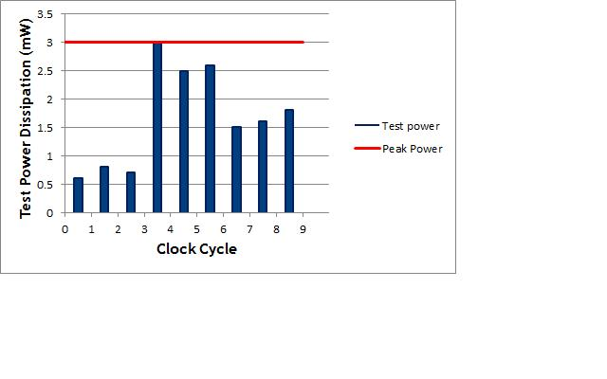
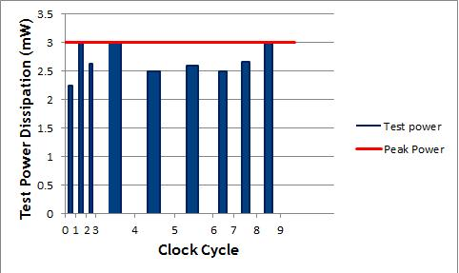
Motivation
Different test vector bits consume different amounts of power
Test frequency chosen based on peak test power consumption
  All test vector bits applied at same frequency
Test vector bits consuming lower power can be applied at higher frequencies without exceeding power budget of chip
Power profile without dynamic clock
Power profile with dynamic clock

Slide 7
Existing Techniques
Existing techniques for test time reduction
  Multiple scan chains
    Number of scan chains in circuit increased => number of flip-flops per scan chain reduced
      Test time depends on longest chain
    Time required to shift test vector bits decreases
    More data per test cycle
Existing techniques for test power reduction
  ATPG algorithms
  Test vector ordering
  Input control
  Modification of scan chain
  Test scheduling algorithms

Slide 8
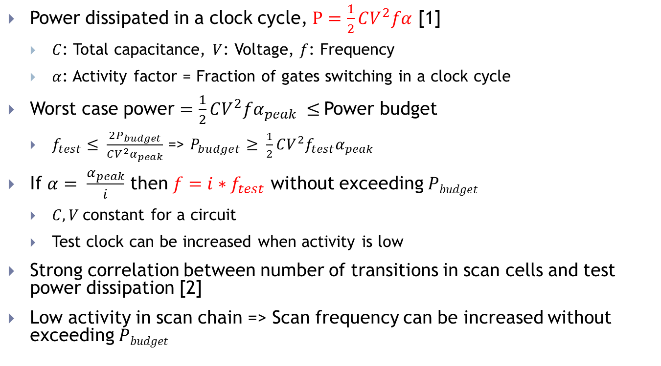
Clock Speed-Up under Power Constraints
Power dissipated in a clock cycle, $P=\frac{1}{2}CV^{2}fα$ [1]
  $C$: Total capacitance, $V$: Voltage, $f$: Frequency
  $α$: Activity factor = Fraction of gates switching in a clock cycle
Worst case power $=\frac{1}{2}CV^{2}fα_{peak} ≤$Power budget
  $f_{test}≤ \frac{2P_{budget}}{CV^{2}α_{peak}}$ => $P_{budget}≥ \frac{1}{2}CV^{2}f_{test}α_{peak}$
If $α= \frac{α_{peak}}{i}$ then $f=i∗f_{test}$ without exceeding $Pbudget$
  $C, V$constant for a circuit
  Test clock can be increased when activity is low
Strong correlation between number of transitions in scan cells and test power dissipation [2]
Low activity in scan chain => Scan frequency can be increased without exceeding $Pbudget$
[1] P. Girard, “Survey of Low-Power Testing of VLSI Circuits,” IEEE Design and Test of Computers, vol. 19, no. 3, pp. 80-90, May-Jun 2002.
[2] N. A. Touba, “Survey of Test Vector Compression Techniques,” IEEE Design and Test of Computers, vol .23, no. 4, pp. 294—303, 2006

Slide 9
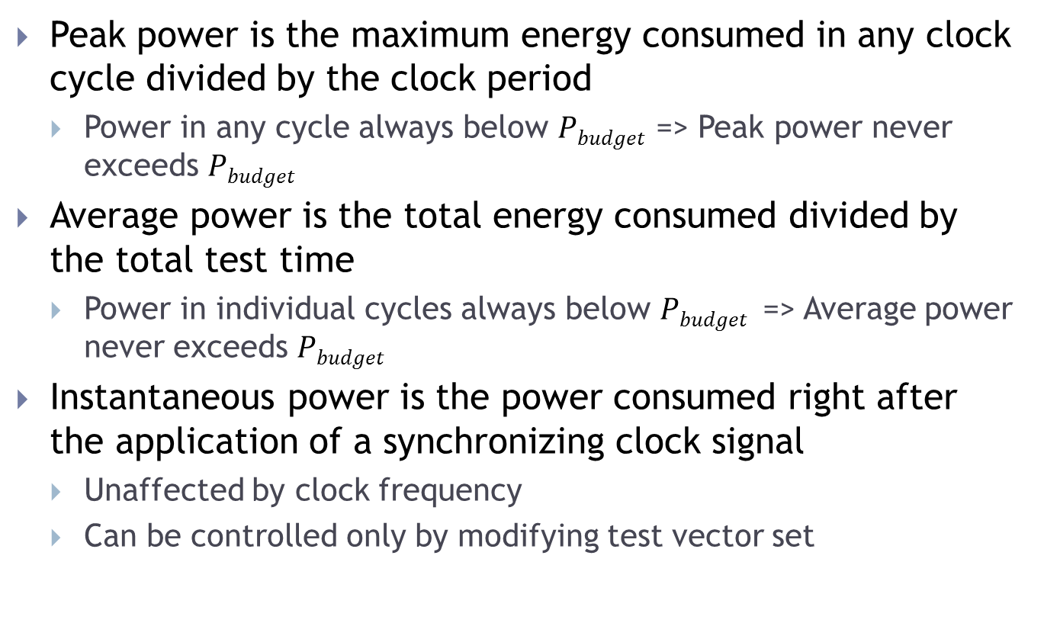
Power during Clock Speed-Up
Peak power is the maximum energy consumed in any clock cycle divided by the clock period
  Power in any cycle always below $Pbudget$ => Peak power never exceeds $Pbudget$
Average power is the total energy consumed divided by the total test time
  Power in individual cycles always below $Pbudget$ => Average power never exceeds $Pbudget$
Instantaneous power is the power consumed right after the application of a synchronizing clock signal
  Unaffected by clock frequency
  Can be controlled only by modifying test vector set
P. Girard, “Survey of Low-Power Testing of VLSI Circuits,” IEEE Design and Test of Computers, vol. 19, no. 3, pp. 80-90, May-Jun 2002.

Slide 10
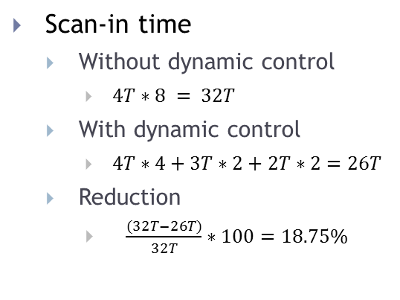
Dynamic Control of Scan Clock
Monitor number of transitions in scan chain
Speed-up scan clock when activity in scan chain is low or slow-down scan clock when activity in scan chain is high
Scan-in time
  Without dynamic control
    $4T∗8 = 32T$
  With dynamic control
    $4T∗4+3T∗2+2T∗2=26T$
  Reduction
    $\frac{(32T−26T)}{32T}∗100=18.75\%$
Example: Dynamic control of scan clock
Non-transition: Present bit in scan chain identical to previous bit (00 or 11)

Slide 11
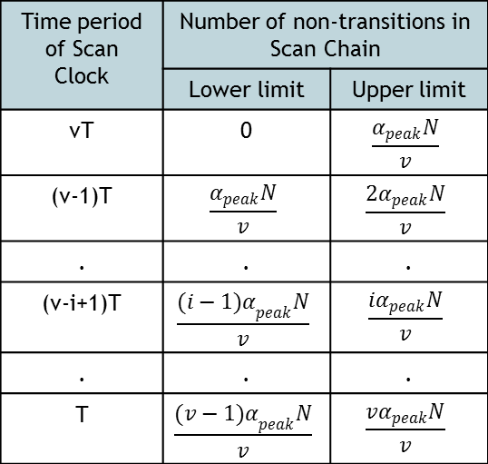
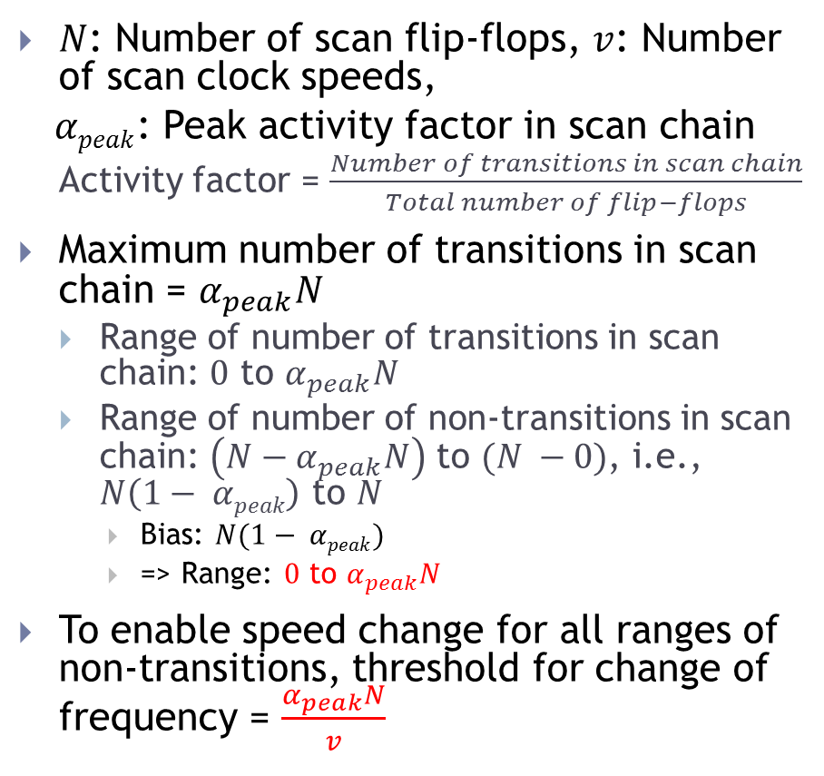
Non-Transition Threshold for Speed Change
$N$: Number of scan flip-flops, $v$: Number of scan clock speeds,
$αpeak$: Peak activity factor in scan chain
  Activity factor = $\frac{Number of transitions in scan chain}{Total number of flip−flops}$
Maximum number of transitions in scan chain = $α_{peak}N$
  Range of number of transitions in scan chain: $0$ to $α_{peak}N$
  Range of number of non-transitions in scan chain: $\left(N−α_{peak}N\right)$ to $(N −0)$, i.e., $N\left(1− αpeak\right)$ to $N$
    Bias: $N(1− αpeak)$
    => Range: $0$ to $α_{peak}N$
To enable speed change for all ranges of non-transitions, threshold for change of frequency = $\frac{α_{peak}N}{v}$
Scan clock frequencies used for various number of non-transitions in scan chain
Time period of Scan Clock | Number of non-transitions in Scan Chain
 | Lower limit | Upper limit
vT | 0 | $$\frac{α_{peak}N}{v}$$
(v-1)T | $$\frac{α_{peak}N}{v}$$ | $$\frac{2α_{peak}N}{v}$$
. | . | .
(v-i+1)T | $$\frac{{(i−1)α}_{peak}N}{v}$$ | $$\frac{iα_{peak}N}{v}$$
. | . | .
T | $$\frac{{(v−1)α}_{peak}N}{v}$$ | $$\frac{vα_{peak}N}{v}$$

Slide 12
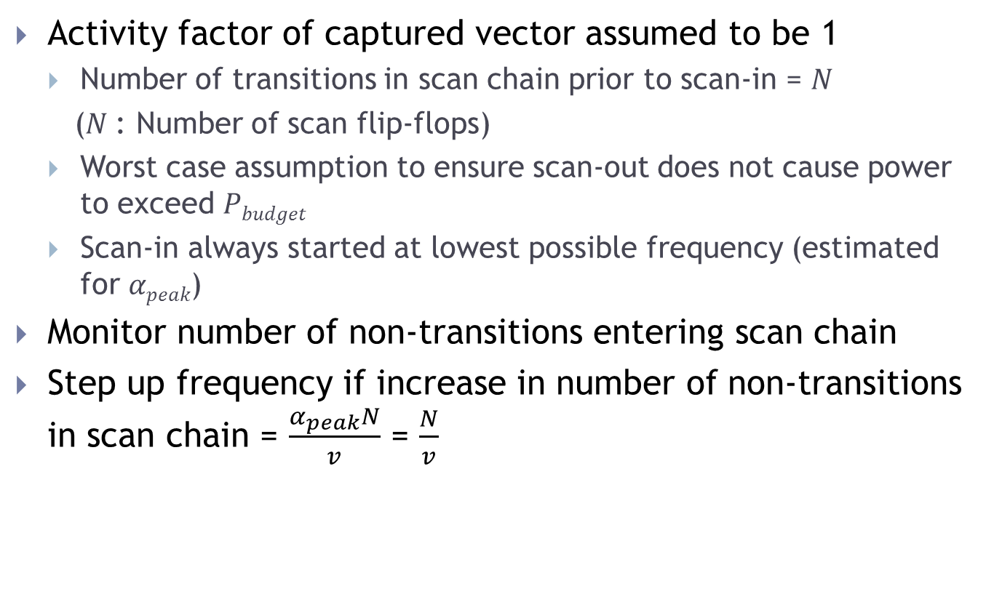
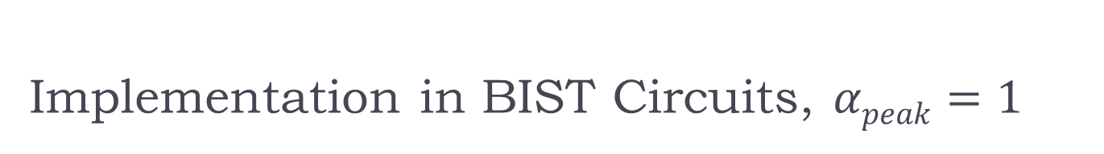
Implementation in BIST Circuits, $αpeak=1$
Activity factor of captured vector assumed to be 1
  Number of transitions in scan chain prior to scan-in = $N$
  ($N$: Number of scan flip-flops)
  Worst case assumption to ensure scan-out does not cause power to exceed $Pbudget$
  Scan-in always started at lowest possible frequency (estimated for $αpeak$)
Monitor number of non-transitions entering scan chain
Step up frequency if increase in number of non-transitions in scan chain = $\frac{α_{peak}N}{v}$ = $\frac{N}{v}$

Slide 13

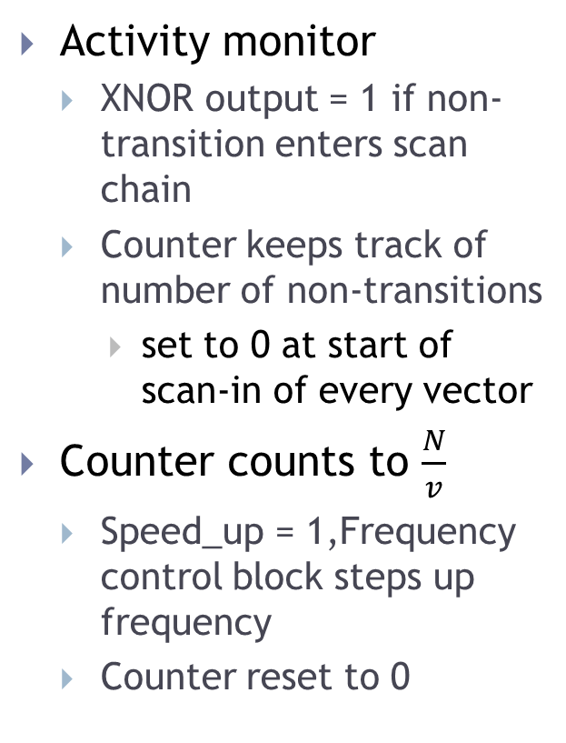
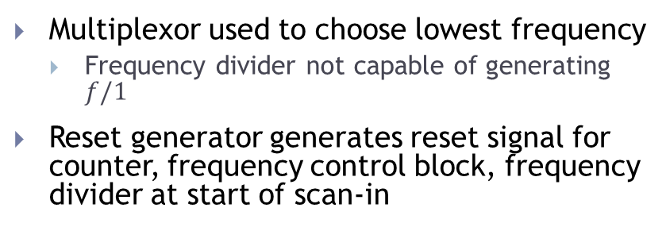
Single Scan Chain, $αpeak=1$
Activity monitor
  XNOR output = 1 if non-transition enters scan chain
  Counter keeps track of number of non-transitions
    set to 0 at start of scan-in of every vector
Counter counts to $\frac{N}{v}$
  Speed_up = 1,Frequency control block steps up frequency
  Counter reset to 0
Implementation in BIST circuits with single scan chain and α_{peak}=1
Multiplexor used to choose lowest frequency
  Frequency divider not capable of generating $f/1$
Reset generator generates reset signal for counter, frequency control block, frequency divider at start of scan-in

Slide 14

Multiple Scan Chains, $αpeak=1$
Activity monitor modified
  XNORs at first flip-flop of every scan chain
  Parallel Counter keeps track of number of non-transitions
    Counts up by number of 1s at its input
Modified activity monitor in BIST circuits with multiple scan chains and α_{peak}=1

Slide 15


Mathematical Analysis - $αpeak=1$
$α_{in}$: Activity factor of scan-in vector, $α_{out}$: Activity factor of captured vector,
$v$: Total number of speeds available, $N$: Number of scan flip-flops
Reduction in scan time
  Computed with respect to scan time when vectors are run at frequency corresponding to $αpeak$
  $\frac{(1−α_{in})}{2} − \frac{1}{2v}$

Slide 16
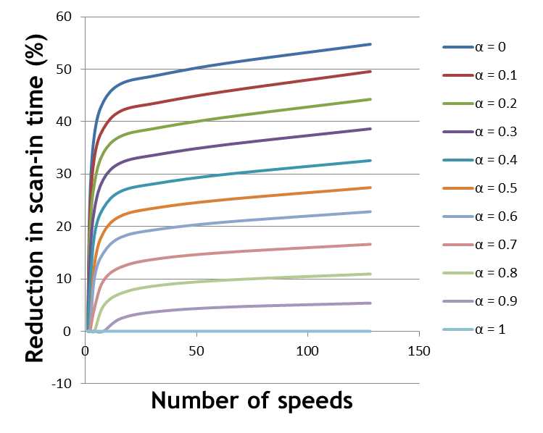

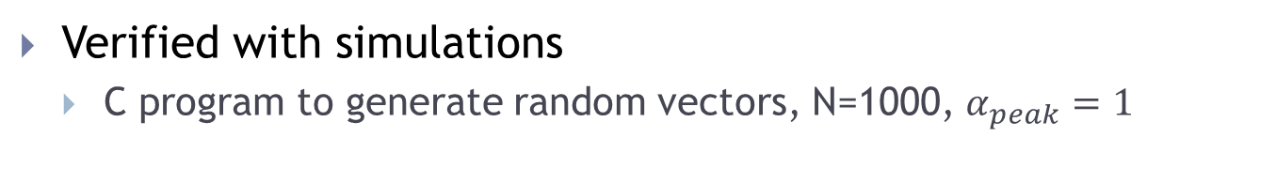

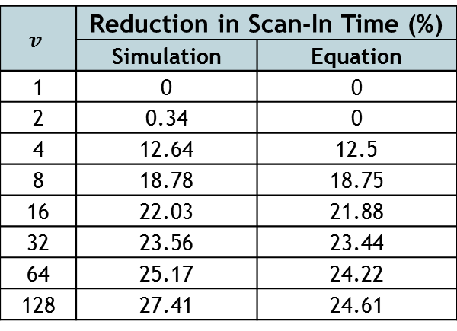
Mathematical Analysis - $αpeak=1$
Verified with simulations
  C program to generate random vectors, N=1000, $α_{peak}=1$
Reduction in scan-in time vs. $v (α_{in} = 0.5)$
$$v$$ | Reduction in Scan-In Time (%)
 | Simulation | Equation
1 | 0 | 0
2 | 0.34 | 0
4 | 12.64 | 12.5
8 | 18.78 | 18.75
16 | 22.03 | 21.88
32 | 23.56 | 23.44
64 | 25.17 | 24.22
128 | 27.41 | 24.61
Variation of scan-in time reduction with $v$ for different values of $α$
Reduction in scan-in time higher for lower $αin$

Slide 17

Experimental Results - $αpeak=1$
Flip-flops added at primary inputs and outputs of Test-per-scan BIST model and chained together
  Total number of scan flip-flops = Number of primary inputs + Number of D-type flip-flops + Number of primary outputs
Circuits built with and without Dynamic Scan Clock Control
  MentorGraphics ModelSim used to find testing time in both cases
  Synopsys DesignCompiler used to estimate area
  Synopsys PrimeTime PX used for power (activity per unit time) analysis
Test-per-scan BIST model (modified)

Slide 18


Experimental Results - $α_{peak} = 1$
Reduction in test time in ISCAS89 benchmark circuits – single scan chain, self tested
Circuit | Number of scan flip-flops | Number of frequencies | Reduction in time (%) | Increase in area (%)
s27 | 8 | 2 | 7.49 | 14.72
s386 | 20 | 4 | 15.25 | 15.29
s838 | 67 | 4 | 13.51 | 11.73
s5378 | 263 | 4 | 13.03 | 6.65
s13207 | 852 | 8 | 19.00 | 3.98
s35932 | 2083 | 8 | 18.74 | 2.55
s38584 | 1768 | 8 | 18.91 | 2.13
Single scan vector
  $α_{in}=0.25$
Test time reduction
  22.5%
Activity per unit time closer to peak limit using dynamic scan clock technique
  Peak limit never exceeded
Activity per unit time analysis (Synopsys PrimeTime PX) – s386 circuit

Slide 19
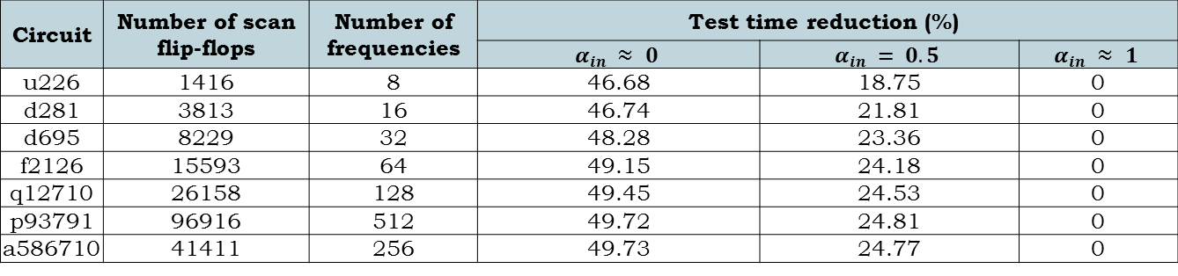
Experimental Results - $α_{peak} = 1$
Reduction in test time in ITC02 benchmark circuits
Circuit | Number of scan flip-flops | Number of frequencies | Test time reduction (%)
 |  |  | $$α_{in} ≈ 0$$ | $$α_{in} = 0.5$$ | $$α_{in} ≈ 1$$
u226 | 1416 | 8 | 46.68 | 18.75 | 0
d281 | 3813 | 16 | 46.74 | 21.81 | 0
d695 | 8229 | 32 | 48.28 | 23.36 | 0
f2126 | 15593 | 64 | 49.15 | 24.18 | 0
q12710 | 26158 | 128 | 49.45 | 24.53 | 0
p93791 | 96916 | 512 | 49.72 | 24.81 | 0
a586710 | 41411 | 256 | 49.73 | 24.77 | 0
a) without don’t care bits (961 vectors)
b) with don’t care bits (14196 vectors)
Distribution of activity factor for test vectors of s38584 circuit

Slide 20
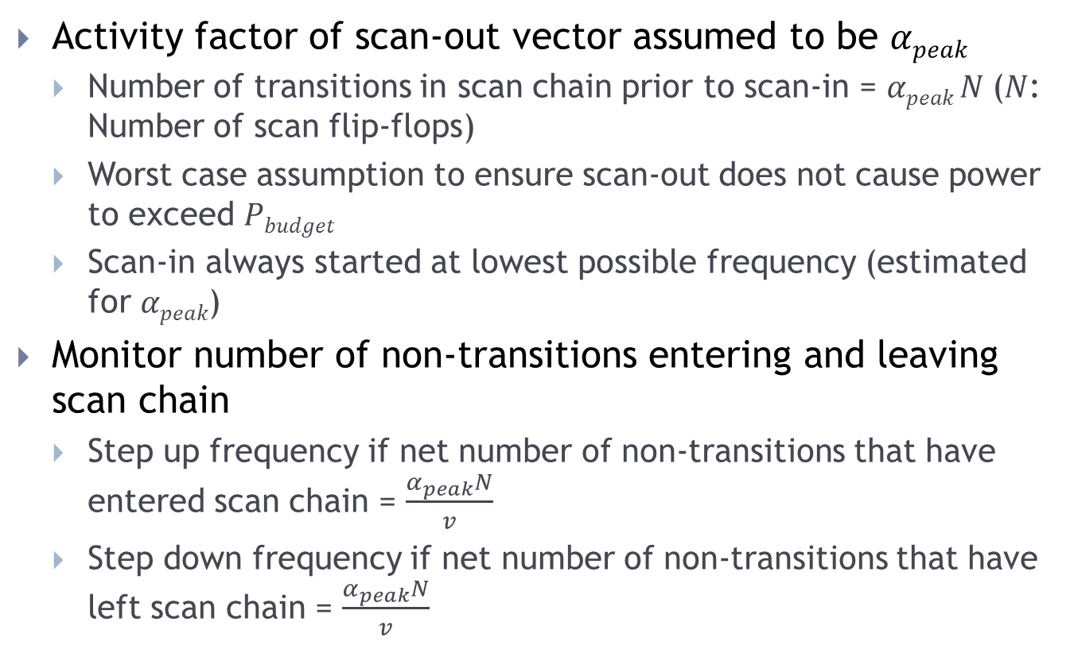

Implementation in BIST Circuits, $αpeak<1$
Activity factor of scan-out vector assumed to be $αpeak$
  Number of transitions in scan chain prior to scan-in = $αpeak N$($N$: Number of scan flip-flops)
  Worst case assumption to ensure scan-out does not cause power to exceed $Pbudget$
  Scan-in always started at lowest possible frequency (estimated for $αpeak$)
Monitor number of non-transitions entering and leaving scan chain
  Step up frequency if net number of non-transitions that have entered scan chain = $\frac{α_{peak}N}{v}$
  Step down frequency if net number of non-transitions that have left scan chain = $\frac{α_{peak}N}{v}$

Slide 21

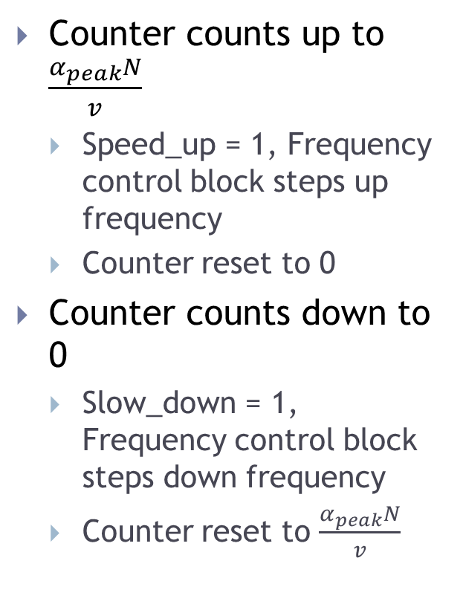
Single Scan Chain, $αpeak<1$
Counter counts up to $\frac{α_{peak}N}{v}$
  Speed_up = 1, Frequency control block steps up frequency
  Counter reset to 0
Counter counts down to 0
  Slow_down = 1, Frequency control block steps down frequency
  Counter reset to $\frac{α_{peak}N}{v}$
Implementation in BIST circuits with single scan chain and α_{peak}<1
Activity monitor
  Count_up = 1 if non-transition enters scan chain
  Count_down = 1 if non-transition leaves scan chain
  Counter keeps track of number of non-transitions
    set to 0 at start of scan-in of every vector

Slide 22

Multiple Scan Chains, $αpeak<1$
Activity monitor modified
  XNORs at first and last flip-flop of every scan chain
  Parallel Counter keeps track of number of non-transitions
    Counts up by number of 1s at Count_up inputs
    Counts down by number of 1s at Count_down inputs
Modified activity monitor in BIST circuits with multiple scan chains and α_{peak}<1

Slide 23


Mathematical Analysis - $αpeak<1$
$α_{in}$: Activity factor of scan-in vector, $α_{out}$: Activity factor of captured vector,
$v$: Total number of speeds available, $N$: Number of scan flip-flops
Reduction in scan time
  Computed with respect to scan time when vectors are run at frequency corresponding to $αpeak$
  $\frac{(α_{out}−α_{in})}{2α_{peak}} − \frac{1}{2v}$

Slide 24


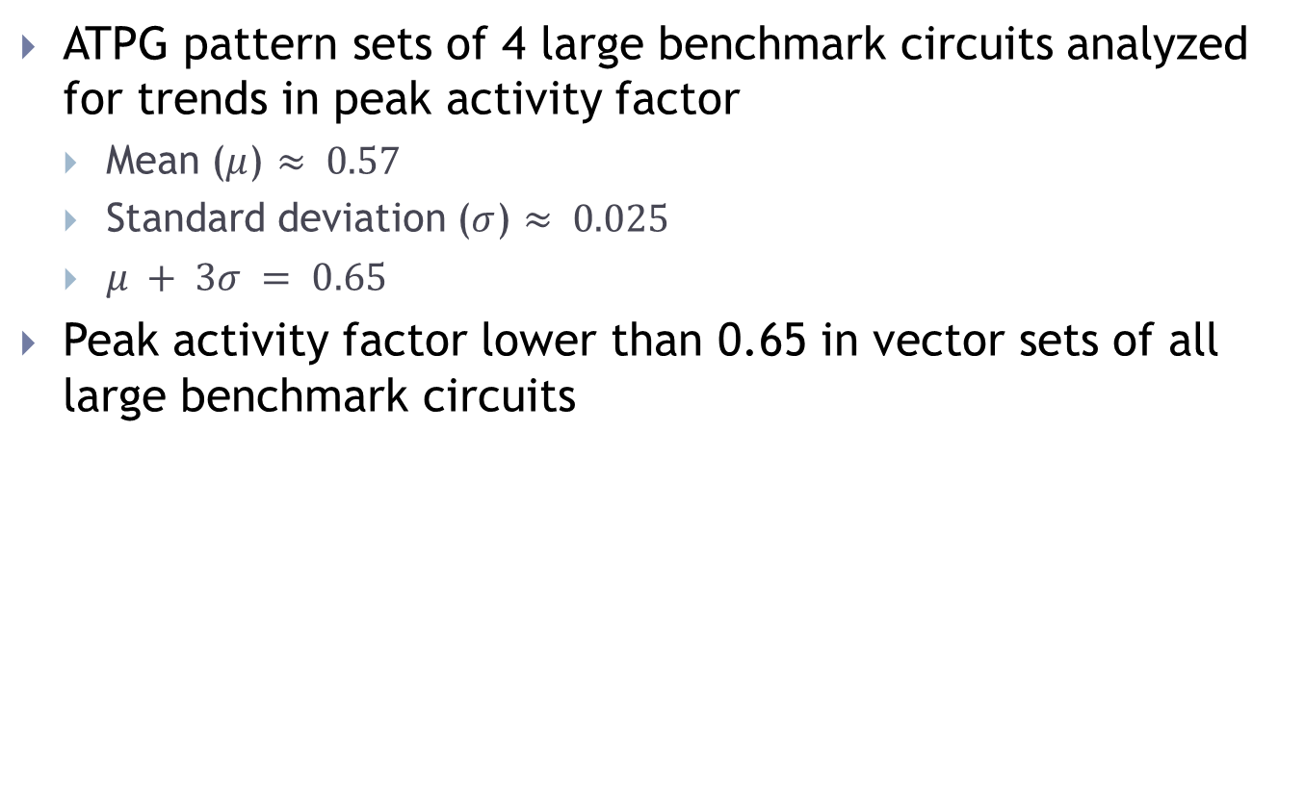
Experimental Results - $α_{peak}< 1$
ATPG pattern sets of 4 large benchmark circuits analyzed for trends in peak activity factor
  Mean ($μ$) $≈ 0.57$
  Standard deviation ($σ$) $≈ 0.025$
  $μ + 3σ = 0.65$
Peak activity factor lower than 0.65 in vector sets of all large benchmark circuits
Normal distribution curve for $αpeak$

Slide 25
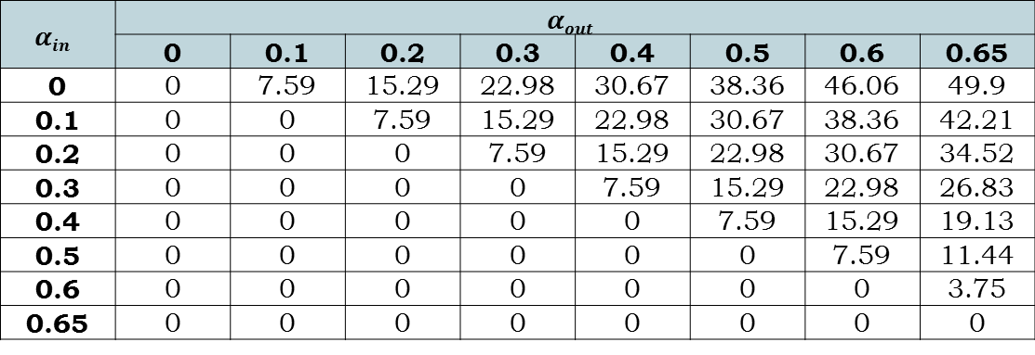

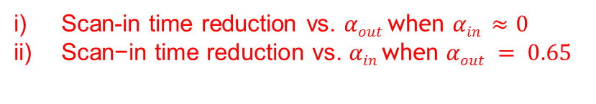
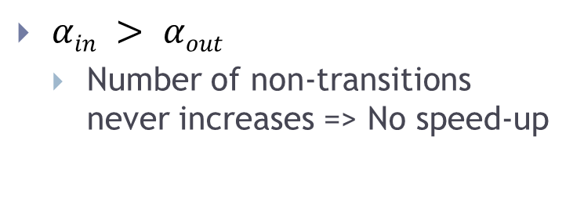
Experimental Results - $α_{peak}=0.65$
Reduction in test time in t512505 circuit
$$αin$$ | $$αout$$
 | 0 | 0.1 | 0.2 | 0.3 | 0.4 | 0.5 | 0.6 | 0.65
0 | 0 | 7.59 | 15.29 | 22.98 | 30.67 | 38.36 | 46.06 | 49.9
0.1 | 0 | 0 | 7.59 | 15.29 | 22.98 | 30.67 | 38.36 | 42.21
0.2 | 0 | 0 | 0 | 7.59 | 15.29 | 22.98 | 30.67 | 34.52
0.3 | 0 | 0 | 0 | 0 | 7.59 | 15.29 | 22.98 | 26.83
0.4 | 0 | 0 | 0 | 0 | 0 | 7.59 | 15.29 | 19.13
0.5 | 0 | 0 | 0 | 0 | 0 | 0 | 7.59 | 11.44
0.6 | 0 | 0 | 0 | 0 | 0 | 0 | 0 | 3.75
0.65 | 0 | 0 | 0 | 0 | 0 | 0 | 0 | 0
$αin > αout$
  Number of non-transitions never increases => No speed-up
Scan-in time reduction vs. $αout$when $αin ≈0$
$\text{Scan}\text{−}\text{in} \text{time} \text{reduction} \text{vs}\text{. }αin \text{when} αout = 0.65$

Slide 26
Implementation in Externally Tested Circuits
Asynchronous protocol [3] necessary for communication between Automatic Test Equipment (ATE) and Device Under Test (DUT)
  Unlike BIST circuitry, patterns are not generated on-chip at the rate of dynamic clock generated on-chip
Synchronizer between ATE and DUT
  Toggles handshake signal when DUT is ready for scan-in
  ATE scans in and scans out next bit and synchronizer toggles handshake signal
  DUT accepts new scan-in bit
Simple asynchronous handshake Protocol
[3] W. J. Dally and J. W. Poulton, Digital Systems Engineering, Cambridge University Press, 1998

Slide 27

Single Scan Chain, $αpeak=1$
Similar to implementation in BIST circuits
  additional synchronizer
Implementation in externally tested circuits with single scan chain and α_{peak}=1
Activity monitor, frequency control block, reset generator and synchronizer can be implemented on-chip, off-chip on performance board or in software (pre-simulated data)
  Trade-off between hardware overhead and test program size
  If dynamic clock is pre-simulated and stored in test program, synchronizer block need not be used

Slide 28
Multiple Scan Chains, $αpeak=1$
Activity monitor modified
  XNORs at first flip-flop of every scan chain
  Parallel Counter keeps track of number of non-transitions
    Counts up by number of 1s at its input
Modified activity monitor in externally tested circuits with multiple scan chains and α_{peak}=1

Slide 29
Single Scan Chain, $αpeak<1$
Implementation in externally tested circuits with single scan chain and α_{peak}<1
Similar to implementation in BIST circuits
  additional synchronizer

Slide 30
Multiple Scan Chains, $αpeak<1$
Activity monitor modified
  XNORs at first and last flip-flop of every scan chain
  Parallel Counter keeps track of number of non-transitions
    Counts up by number of 1s at Count_up inputs
    Counts down by number of 1s at Count_down inputs
Modified activity monitor in externally tested circuits with multiple scan chains and α_{peak}<1

Slide 31
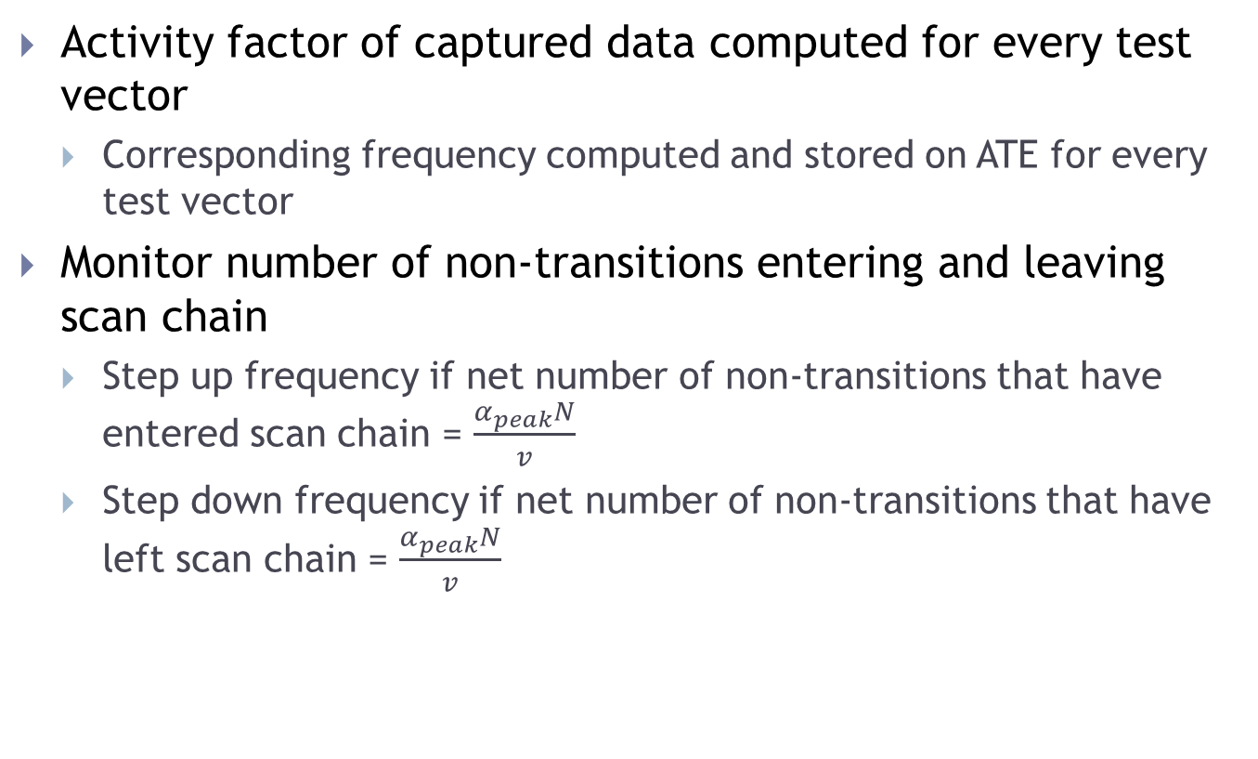
Pre-Determined Start Frequency
Activity factor of captured data computed for every test vector
  Corresponding frequency computed and stored on ATE for every test vector
Monitor number of non-transitions entering and leaving scan chain
  Step up frequency if net number of non-transitions that have entered scan chain = $\frac{α_{peak}N}{v}$
  Step down frequency if net number of non-transitions that have left scan chain = $\frac{α_{peak}N}{v}$

Slide 32
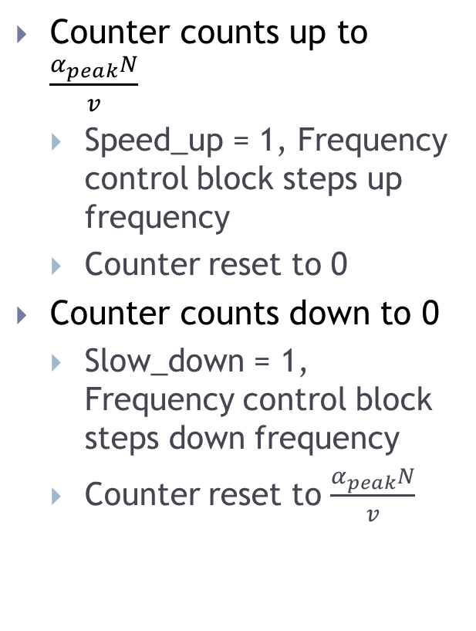
Pre-Determined Start Frequency, Single Scan Chain
Counter counts up to $\frac{α_{peak}N}{v}$
  Speed_up = 1, Frequency control block steps up frequency
  Counter reset to 0
Counter counts down to 0
  Slow_down = 1, Frequency control block steps down frequency
  Counter reset to $\frac{α_{peak}N}{v}$
Implementation with Pre-Determined Start Frequency
Reset Generator
  Resets up-down counter to 0 at start of scan-in of every vector
  Resets frequency divider block with Frequency_start at start of scan-in of every vector

Slide 33

Mathematical Analysis
$α_{in}$: Activity factor of scan-in vector, $α_{out}$: Activity factor of captured vector,
$v$: Total number of speeds available, $N$: Number of scan flip-flops
Reduction in scan time
  Computed with respect to scan time when vectors are run at frequency corresponding to $αpeak$
  $\frac{\left(α_{peak}−α_{in}\right) + (α_{peak}−α_{out})}{2α_{peak}} ± \frac{1}{2v}$

Slide 34
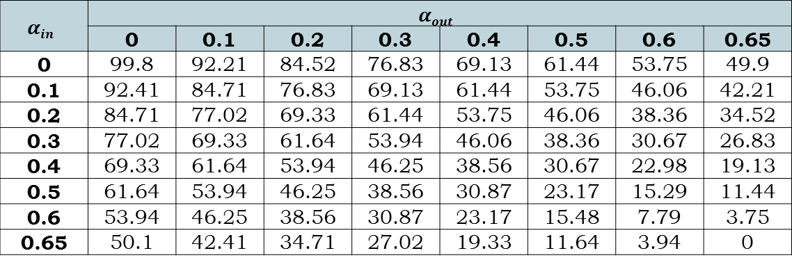
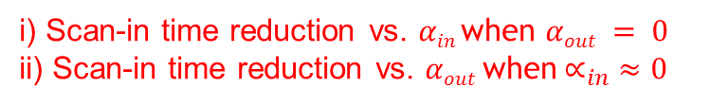
Experimental Results
Reduction in test time in t512505 circuit
$$αin$$ | $$αout$$
 | 0 | 0.1 | 0.2 | 0.3 | 0.4 | 0.5 | 0.6 | 0.65
0 | 99.8 | 92.21 | 84.52 | 76.83 | 69.13 | 61.44 | 53.75 | 49.9
0.1 | 92.41 | 84.71 | 76.83 | 69.13 | 61.44 | 53.75 | 46.06 | 42.21
0.2 | 84.71 | 77.02 | 69.33 | 61.44 | 53.75 | 46.06 | 38.36 | 34.52
0.3 | 77.02 | 69.33 | 61.64 | 53.94 | 46.06 | 38.36 | 30.67 | 26.83
0.4 | 69.33 | 61.64 | 53.94 | 46.25 | 38.56 | 30.67 | 22.98 | 19.13
0.5 | 61.64 | 53.94 | 46.25 | 38.56 | 30.87 | 23.17 | 15.29 | 11.44
0.6 | 53.94 | 46.25 | 38.56 | 30.87 | 23.17 | 15.48 | 7.79 | 3.75
0.65 | 50.1 | 42.41 | 34.71 | 27.02 | 19.33 | 11.64 | 3.94 | 0
Significant reduction in test time
  Activity in scan chain known
i) Scan-in time reduction vs. $αin$when $αout = 0$
ii) Scan-in time reduction vs. $αout$when$∝_{in} ≈0$

Slide 35
Conclusion
Dynamic control of scan clock frequency proposed
  Reduces testing time without exceeding power budget
  On-chip activity monitor for self testing circuits to keep track of activity in scan chain
  On-chip or off-chip activity monitor for externally tested circuits
  Asynchronous protocol used for communication between ATE and DUT
Vectors with low average scan-in activity (with much higher peak activity) achieve high reduction in test time
Method can be implemented in circuits using compression hardware
  Activity monitored at every internal scan chain
Up to 50% reduction in test time achieved in circuits when start frequency not pre-determined
  Results more significant when start frequency is pre-determined

Slide 36
Thank You!

